Slide 1
Do Congress Members’ Trades Outperform the Stock Market
Ryan Morrow

Slide 2
Research Questions with Analysis so far
Question 1: How does the average stock market return of congress members compare to the market?
Question 2: Do congress members’ trades in the stock market overperform the stock market at a statistically significant level?
Question 3: Does the Republican Party (known for its support of capitalism) outperform the Democratic Party in the stock market at a statistically significant level?

Slide 3
Data Dictionary
Name | String | Congress member’s name
Ticker | String | The stock market ticker of the stock that the congress member traded
Party | String | The political party the congress member is affiliated with
Chamber | String | The chamber of Congress the congress member serves in (House or Senate).
State | String | The state that the congress member represents
Buy Date | String | The earliest date within the sample that the congress member bought shares of the traded stock
Sell Date | String | The latest date within the sample that the congress member sold shares of the traded stock
Buy Price | Float | The opening price of the traded stock on the Buy Date (or closest valid date).
Sell Price | Float | The closing price of the traded stock on the Sell Date (or closest valid date).
Trade Return % | Float | The traded stock’s return as a % using: Return % = 100 * ((Sell Price – Buy Price)/Buy Price)
Market Buy Price | Float | The opening price of the market baseline stock on the Buy Date (or closest valid date).
Market Sell Price | Float | The closing price of the market baseline stock on the Sell Date (or closest valid date).
Market Return % | Float | The market baseline stock’s return as a % using: Return % = 100 * ((Sell Price – Buy Price)/Buy Price)
Overperformance % | Float | The target variable represents how much better the traded stock performed than the market baseline stock over the same period using: Overperformance % = Trade Return % - Market Return %
Days Held` | Integer | The number of days the stock was held for: Days Held = Sell Date – Buy Date

Slide 4
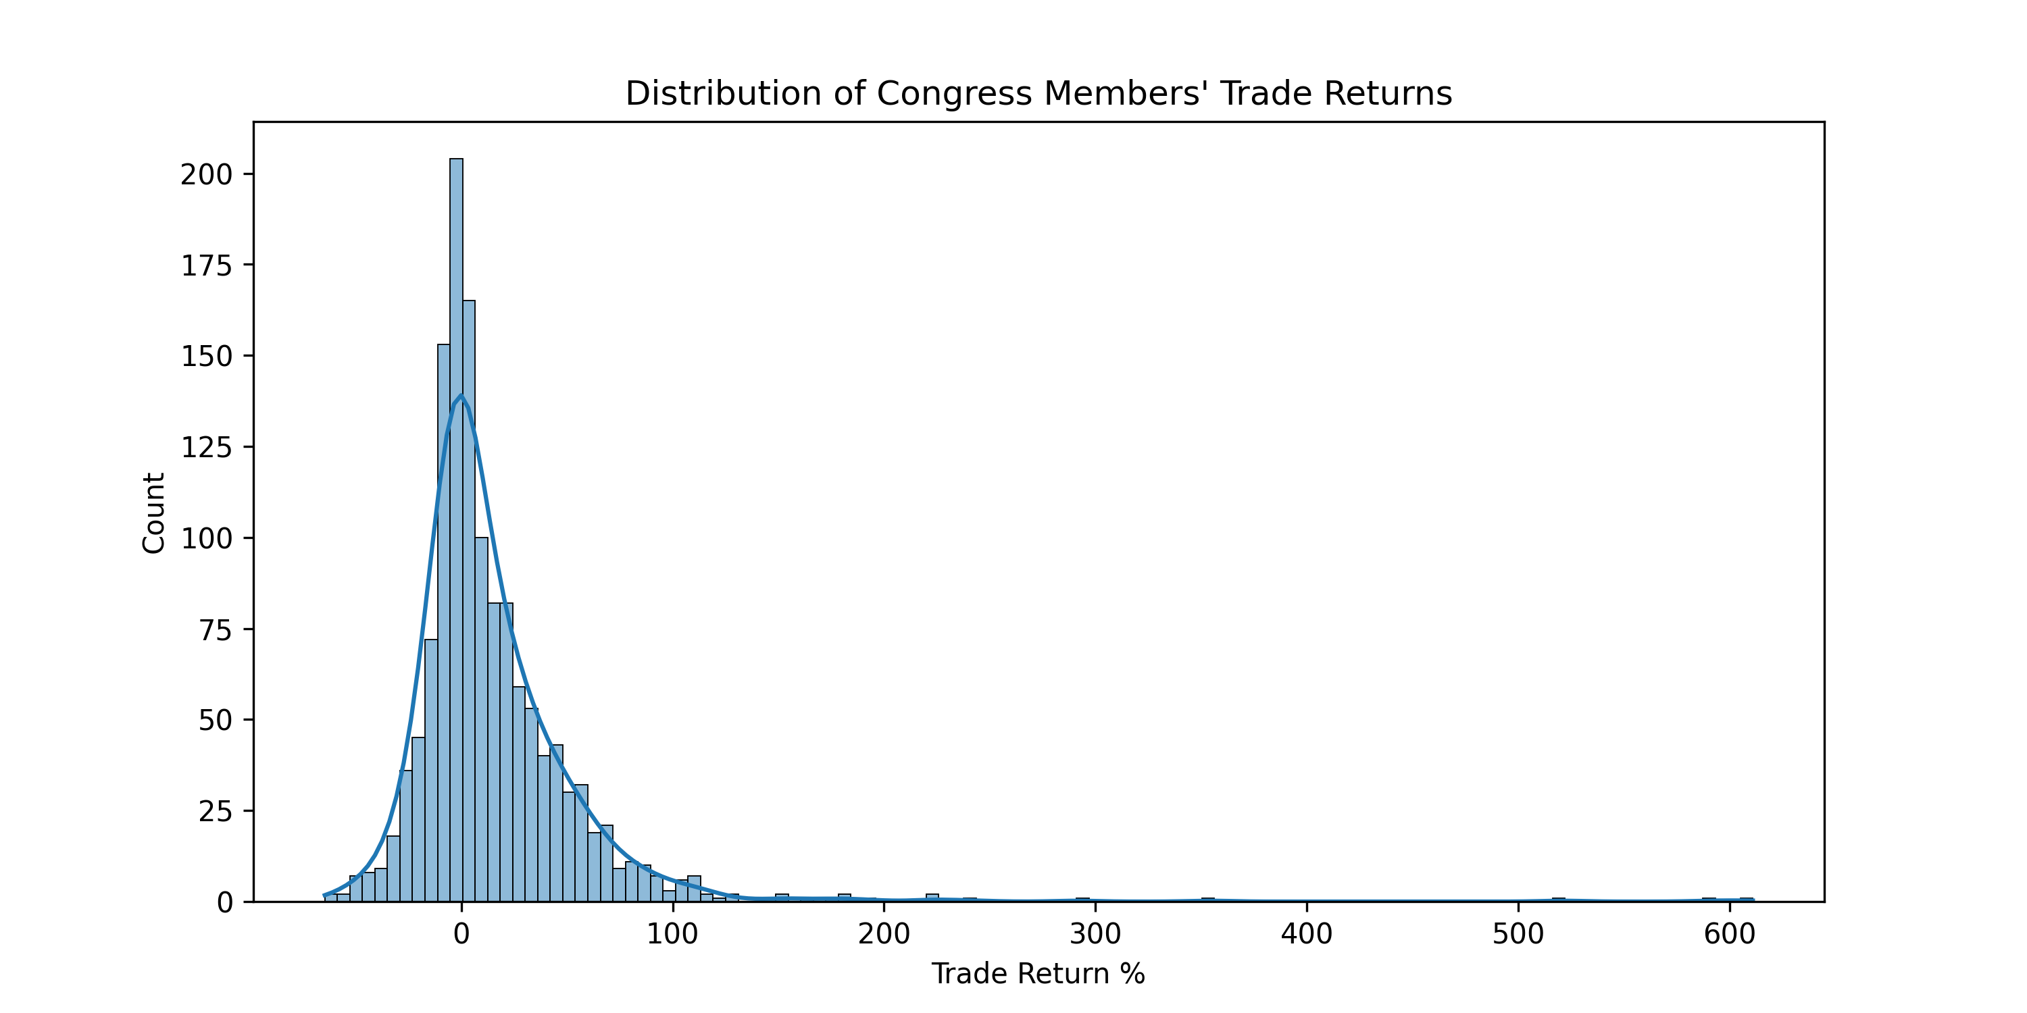
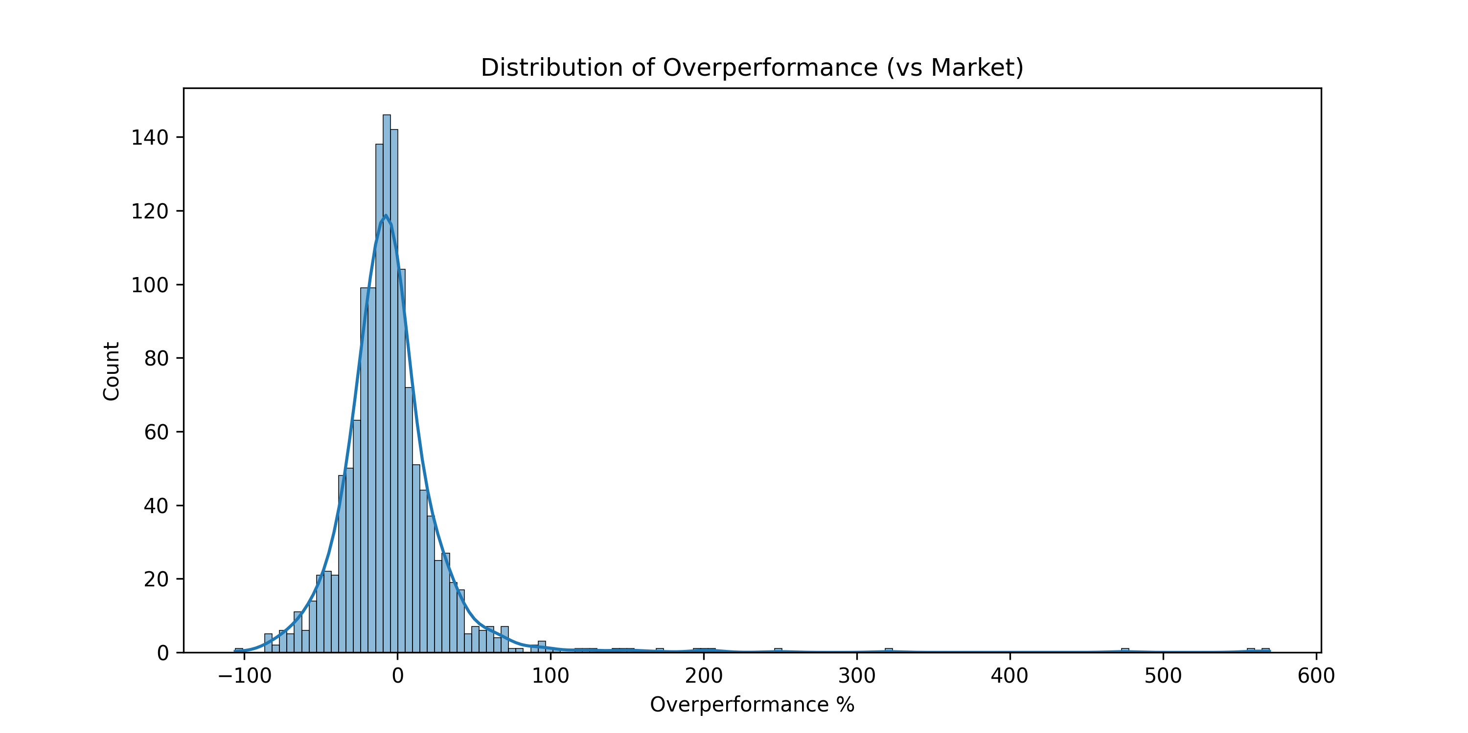
Univariate Analysis: Questions 1+2
count 1356.000000
mean 15.381012
std 43.785024
min -64.497670
25% -5.537237
50% 4.962183
75% 27.510816
max 610.853201
Name: Trade Return %, dtype: float64
count 1355.000000
mean -4.039460
std 40.507125
min -105.954546
25% -20.918172
50% -7.151286
75% 5.779736
max 569.396325
Name: Overperformance %, dtype: float64

Slide 5
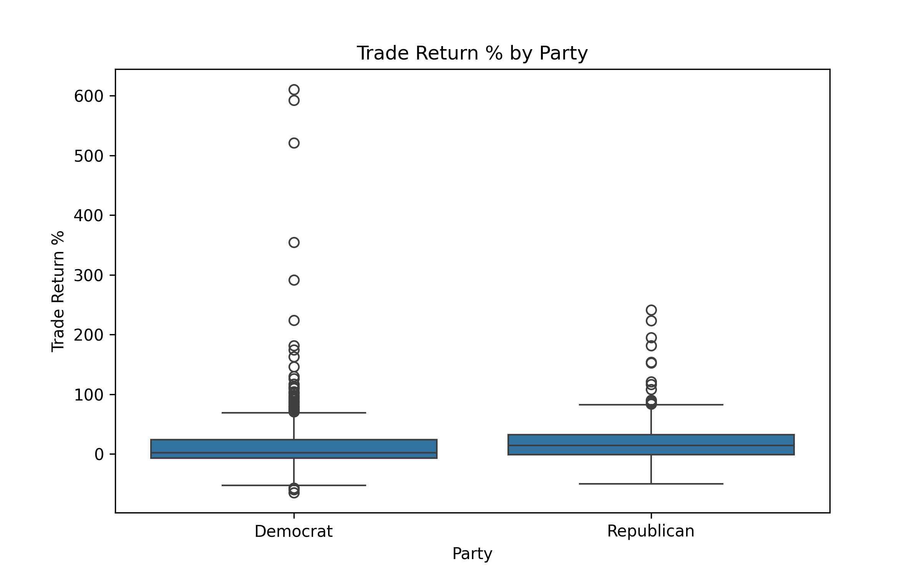
Bivariate Analysis: Question 3

Slide 6
Hypothesis Tests: Questions 1-3
Test | P_Val | Result
Congress members' returns overperform the market at a statistically significant level | 0.999874 | FALSE
Congress members' returns underperform the market at a statistically significant level | 0.000126 | TRUE
Congress members' returns perform differently than the market at a statistically significant level | 0.000251 | TRUE
Democrat Congress Members outperform Republican Congress Members in the stock market at a statistically significant level. | 0.995274 | FALSE
Democrat Congress Members underperform Republican Congress Members in the stock market at a statistically significant level. | 0.004726 | TRUE
Democrat Congress Members's returns are different than Republican Congress Members' returns in the stock market at a statistically significant level. | 0.009452 | TRUE

Slide 7
Machine Learning
Can we predict which trades will outperform the market based on the party, chamber, state, and number of days held?
Using a Random Forest Classifier
 | precision | recall | f1-score | support
0 | 0.675676 | 0.862069 | 0.757576 | 174
1 | 0.52 | 0.265306 | 0.351351 | 98
accuracy | 0.647059 | 0.647059 | 0.647059 | 0.647059
macro avg | 0.597838 | 0.563688 | 0.554464 | 272
weighted avg | 0.619587 | 0.647059 | 0.611215 | 272

Slide 8
Roadmap to Finishing Project
By 4/30: Analyze and answer Question 4: Does one chamber outperform the other in the stock market at a statistically significant level?
By 5/4: Conduct additional analyses and visualizations as necessary.
By 5/9: Write Report

Slide 9
Questions
Do I need to go in-depth on the Machine Learning even though it does not answer my research questions?
How long does the report have to be?

